Slide 1
Pwm drawer project
Presented by: Mahmoud Mohamed Ali
Email: mahmoud43704@gmail.com
Supervised by: AMIT

Slide 2
CONTENT
PWM meaning & importance
Main parameters for PWM
Aim of project
Output

Slide 3
PWM meaning & importance
Microcontroller is a digital device (0, 1)
Gives 0 volts or 5 volts
Some Microcontrollers give digital output 0 volts or 3.3 volts
Analog output between 0 to 5 or 0 to 3.3
All data received are digital

Slide 4
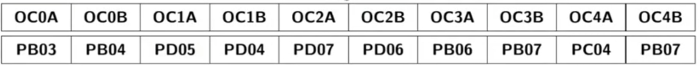
PWM meaning & importance
Pulse Width Modulation
Gives output between 0 and 5 volts like analog output
PWM pins in ATmega32

Slide 5

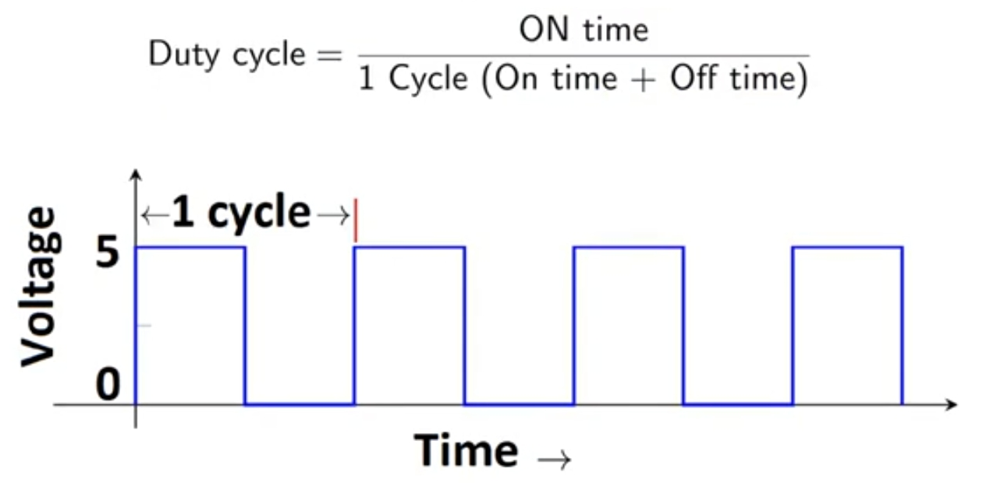
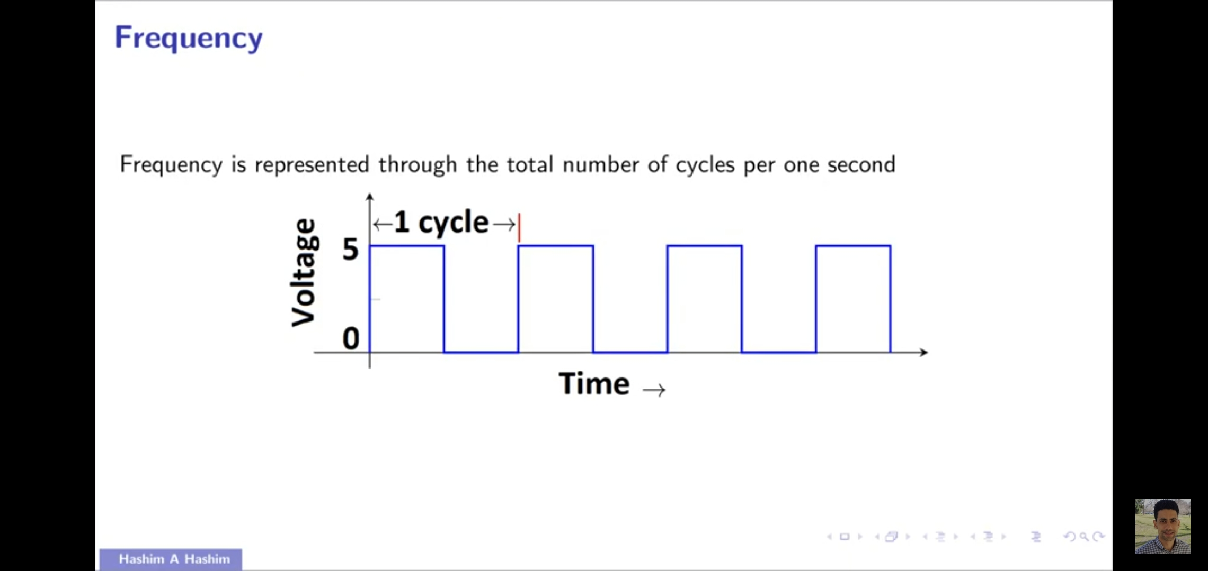
Main parameters for PWM
Frequency
  it representing the total number of cycles per one second
Duty Cycle
  Is defined with respect to percentage or as a
  number between 0 and 1

Slide 6
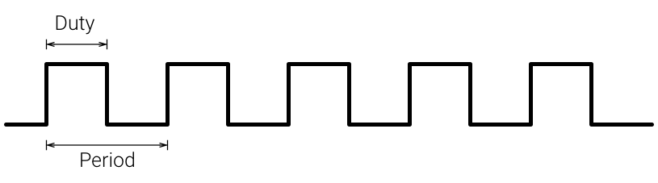
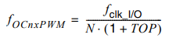
Aim of project
Draw Pulses diagram
Calculating Frequency, Duty Cycle
Graphic LCD bitmap generator
N of Presscallers
Top of Counter

Slide 7
Output
Timer1
  16 bits (0 – 65535)
  Timer0 (8 bits, 0 - 255)
Pulse width measurement
Period measurement
Capturing the time of an event
rising edge or falling edge on ICP pin , the TCNT1 value is loaded into the ICR1 (input capture) register and the ICF1 flag will get set.

Slide 8
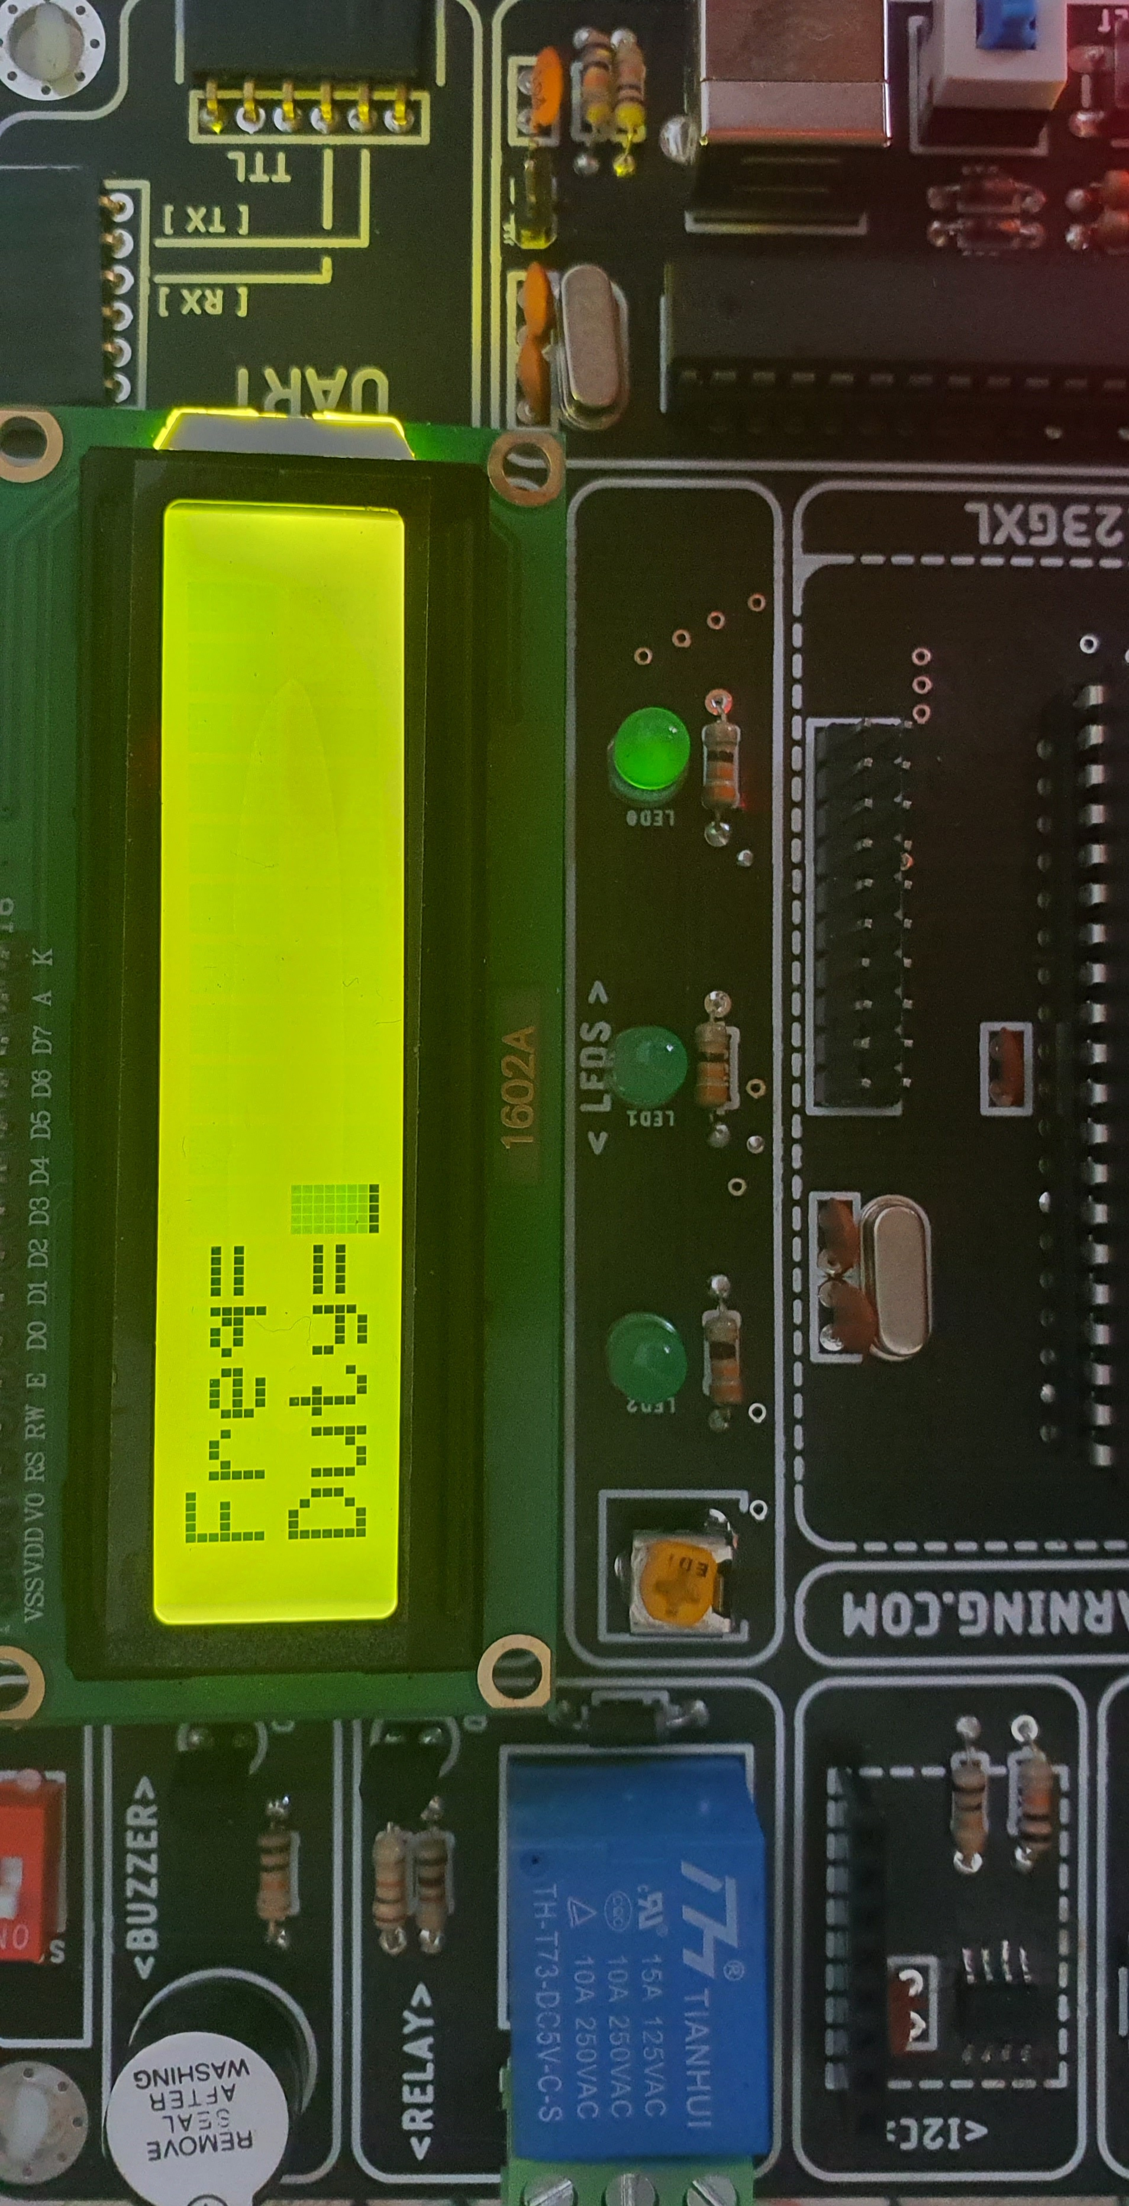
Output
Initializing TCCR1A and TCCR1B for proper timer mode (any mode other than 8, 10, 12, 14), to select the edge.
Monitor the ICF1 flag in the TIFR register to see if the edge has arrived. Upon the arrival of the edge, the TCNT1 value is loaded into the ICR1 register automatically by the controller.

Slide 9
References
ATmega32 Datasheet
Thank You

